Slide 1

Data Communication and Computer Networks
7. Network Layer
PART-B
Dr. Aiman Hanna
Department of Computer Science & Software Engineering Concordia University, Montreal, Canada
These slides has mainly been extracted, modified and updated from original slides of : Computer Networking: A Top Down Approach, 6th edition Jim Kurose, Keith Ross Addison-Wesley, 2013
Additional materials have been extracted, modified and updated from: Understanding Communications and Networking, 3e by William A. Shay 2005
Copyright © 1996-2013 J.F Kurose and K.W. Ross
Copyright © 2005 William A. Shay
Copyright © 2018 Aiman Hanna All rights reserved
Network Layer B

Slide 2
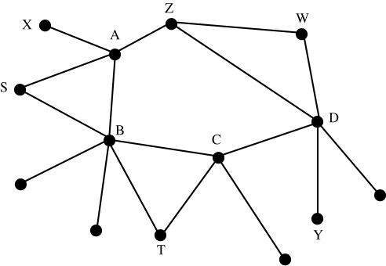
Wide Area Networks (WANs)
Wide Area Networks, WANs, are large networks that may span the globe
WANs have a generalized topologies and require more sophisticated techniques to perform what they are expected to
Generalized Network Topology
Network Layer B

Slide 3
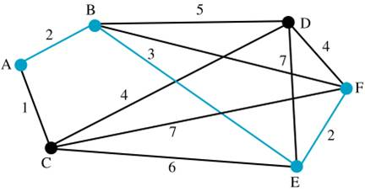
Routing Tables
these table do not normally specify the entire route
rather, they specify the next node in a route to a specified destination, and the cost to get there
Network Example
Network Layer B

Slide 4
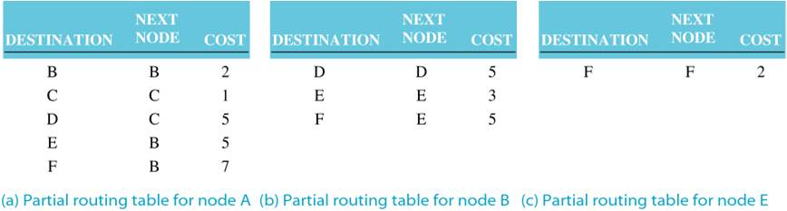
Routing Tables
Example: partial tables for the routers shown in the example network
Partial Routing Tables for A, B & E
Network Layer B

Slide 5
Graph abstraction
5
v
3
w
2
5
u
2
1
z
3
1
2
x
y
1
graph: G = (N,E) - Nodes and Edges
N = set of nodes/routers = { u, v, w, x, y, z }
E = set of links/edges
= { (u,v), (u,x), (v,x), (v,w), (x,w), (x,y), (w,y), (w,z), (y,z) }
Network Layer B

Slide 6
Graph abstraction: costs
5
c(x,x’) = cost of link (x,x’)
e.g., c(w,z) = 5
cost could always be 1, or
inversely related to bandwidth,
or inversely related to
congestion
v
3
w
2
5
u
2
1
z
3
1
2
x
y
1
cost of path (x₁, x₂, x₃,…, x_{p}) = c(x₁,x₂) + c(x₂,x₃) + … + c(x_{p-1},x_{p})
key question: what is the least-cost path between u and z ?
routing algorithm: algorithm that finds that least cost path
Network Layer B

Slide 7
Routing algorithm classification
Q: global or decentralized information?
global:
all routers have complete topology, link cost info
“link state” algorithms
decentralized:
router knows physically-connected neighbors, link costs to neighbors
iterative process of computation, exchange of info with neighbors
“distance vector” algorithms
Q: static or dynamic?
static:
routes change slowly over time
dynamic:
routes change more quickly
periodic update
in response to link cost changes
Network Layer B

Slide 8
Routing algorithm classification
Centralized Routing
all interconnection information is generated and maintained at a single central station
that station then broadcasts this information to all network nodes, so they can define their own routing tables
one way to maintain the central information is through routing matrix
Network Layer B

Slide 9
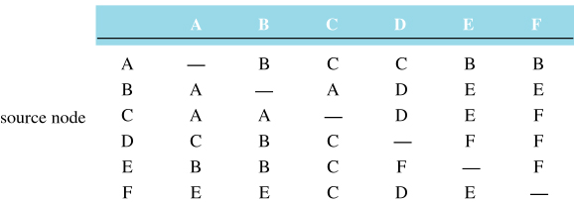
Routing algorithm classification
Centralized Routing
Routing Matrix for the Example Network
Network Layer B

Slide 10
Routing algorithm classification
Distributed Routing
no central control; each node must determine and maintain routing information independently
this can be achieved by knowing the neighbors, cost to get to a neighbor and the cost from that neighbor to a destination
more complex than centralized since each node must communicate with each of its neighbors instead of just one central station
the complexity is driven also by the fact that the devices have a very limited knowledge of the entire network
Network Layer B

Slide 11
Routing algorithm classification
Static Routing
once the node determines the routing table, it does not change it
in other words, the initial cheapest path may not really be the cheapest path after sometime, yet it is always considered as the cheapest path
the assumption here is that the conditions that led to the initial definition of the tables do not change
sometimes, this is a reasonable assumption, when?
Network Layer B

Slide 12
Routing algorithm classification
Adaptive Routing
allows the network to respond to changes and update its routing tables accordingly
if the cost of the route to be used changed, then adapt and use another route
could this lead to serious problems sometime?
in general, it is difficult to implement adaptive routing efficiently, why?
Network Layer B

Slide 13
A Link-State Routing Algorithm
Dijkstra’s algorithm
sometimes called the Shortest-path Algorithm or Forward Search Algorithm
centralized, static algorithm, however it can be made adaptive by executing it periodically
a node executing this algorithm is required to know the link costs among the nodes
each node executes this algorithm to determine the cheapest route to each network node
Network Layer B

Slide 14
A Link-State Routing Algorithm
Dijkstra’s algorithm
net topology, link costs known to all nodes
accomplished via “link state broadcast”
all nodes have same info
computes least cost paths from one node (‘source”) to all other nodes
gives forwarding table for that node
iterative: after k iterations, know least cost path to k destinations
notation:
c(x,y): link cost from node x to y; = ∞ if not direct neighbors
D(v): current value of cost of path from source to dest. v
p(v): prior (predecessor) node along path from source to v
S: set of nodes whose least cost path definitively known
Network Layer B

Slide 15
Dijsktra’s Algorithm
1 Initialization:
2 S = {u}
3 for all nodes v
4 if v adjacent to u
5 then D(v) = c(u,v)
6 else D(v) = ∞
7
8 Loop
9 find w not in S such that D(w) is a minimum
10 add w to S
11 update D(v) for all v adjacent to w and not in S :
12 D(v) = min( D(v), D(w) + c(w,v) )
13 /* new cost to v is either old cost to v or known
14 shortest path cost to w plus cost from w to v */
15 until all nodes in S
Network Layer B

Slide 16
Dijsktra’s Algorithm
Iterative procedure.
C: Set of nodes to which cheap route is known,
S: Set of nodes directly connected to a node in C,
X: A node in S to where cheap path found
C
S
X
Distances yet to be determined
v
u
Distances to potential vertices
Potential vertex with shortest distance
X
Selected vertex to move to C
Different routes to u.
Is there a cheaper route through X to other vertices in S? If so, update distances to these vertices.
Shortest Paths

Slide 17
Dijsktra’s Algorithm
In details, the algorithm performs the repeated moving operations from S to C as follows:
Move one vertex from S to C. Let us refer to that vertex as X. This vertex, X, must satisfy the following:
It is either directly connected to v or directly connected to another vertex that is already in C
Has the smallest distance to v among all the potential vertices that are considered for movement to C
Whenever the vertex X is moved to C, its distance is the smallest distance (shortest path) to v
Additionally, once this vertex X is chosen, move it to C and recheck all distances of all vertices that have direct connection to X and are NOT yet in C. If a smaller value than what we already have is found, update this value
In each step, we also update how to go to these vertices (that is, through which vertex); we refer to this vertex as the prior function
The steps are repeated until all the graph vertices are moved to C. The final obtained distances represent the shortest paths, and the prior functions indicate the direction from v (through which vertex) to obtain these shortest paths to each of the other vertices in the graph
Shortest Paths

Slide 18
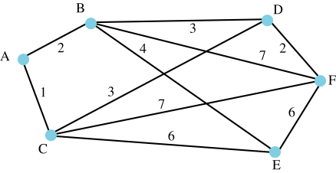
Dijsktra’s Algorithm - Example
Network and Associated Connection Costs
Network Layer B

Slide 19
Dijsktra’s Algorithm - Example
Cost function Prior function
 | C | Potential elements of S | X | A | B | C | D | E | F | A | B | C | D | E | F
0 | {} | {A} | A | 0 | ∞ | ∞ | ∞ | ∞ | ∞ | A | - | - | - | - | -
1 | {A} | {B,C} | C | 0 | 2 | 1 | ∞ | ∞ | ∞ | A | A | A | - | - | -
2 | {A, C} | {B,D,E,F} | B | 0 | 2 | 1 | 4 | 7 | 8 | A | A | A | C | C | C
3 | {A,B,C} | {D,E,F} | D | 0 | 2 | 1 | 4 | 6 | 8 | A | A | A | C | B | C
4 | {A,B,C,D} | {E,F} | E | 0 | 2 | 1 | 4 | 6 | 6 | A | A | A | C | B | D
5 | {A,B,C,D,E} | {F} | F | 0 | 2 | 1 | 4 | 6 | 6 | A | A | A | C | B | D
‹#›
Note: See comments attached to this slide for detailed information on how the operations progressed.

Slide 20
Dijkstra’s algorithm: example
resulting shortest-path tree from A:
B
D
A
F
C
E
resulting forwarding table in A:
destination
link
B
(A,B)
C
(A,C)
D
(A,C)
E
(A,B)
F
(A,C)
Network Layer B

Slide 21
Hierarchical routing
our routing study thus far - idealization
all routers identical
all run the same routing algorithm
network “flat”
… not true in practice
scale: with 600 million destinations:
cannot store all dest’s in routing tables!
routing table exchange would swamp links!
administrative autonomy
internet = network of networks
each network admin may want to control routing in its own network, while still being able to connect to other networks
Network Layer B

Slide 22
Hierarchical routing
organize routers into regions, “autonomous systems” (AS)
routers in same AS:
typically under the same admin control (i.e. operated by same ISP, or belonging to same company)
run same routing protocol
“intra-AS” routing protocol
routers in different AS can run different intra-AS routing protocol
gateway router:
an “edge” of its own AS
has the task of forwarding packets to destination outside its AS
has link to router in another AS
Network Layer B

Slide 23
Interconnected ASes
3c
3a
2c
3b
2a
AS3
2b
1c
AS2
1a
1b
1d
AS1
forwarding table configured by both intra- and inter-AS routing algorithm
intra-AS sets entries for internal dests
inter-AS & intra-AS sets entries for external dests
Intra-AS
Routing
algorithm
Inter-AS
Routing
algorithm
Forwarding
table
Network Layer B

Slide 24
Inter-AS tasks
suppose router in AS1 receives datagram destined outside of AS1:
router should forward packet to gateway router, but which one?
AS1 must:
learn which dests are reachable through AS2, which through AS3
propagate this reachability info to all routers in AS1
job of inter-AS routing!
3c
3a
3b
AS3
2c
other
networks
1c
2a
other
networks
1a
2b
1b
AS2
AS1
1d
Network Layer B

Slide 25
Example: setting forwarding table in router 1d
suppose AS1 learns (via inter-AS protocol) that subnet x reachable via AS3 (gateway 1c), but not via AS2
inter-AS protocol propagates reachability info to all internal routers
router 1d determines from intra-AS routing info that its interface I is on the least cost path to 1c
installs forwarding table entry (x,I)
…
x
3c
3a
3b
AS3
2c
other
networks
1c
2a
other
networks
1a
2b
1b
AS2
AS1
1d
Network Layer B

Slide 26
Example: choosing among multiple ASes
now suppose AS1 learns from inter-AS protocol that subnet x is reachable from AS3 and from AS2.
to configure forwarding table, router 1d must determine which gateway it should forward packets towards for dest x
this is also job of inter-AS routing protocol!
…
x
3c
……
3a
3b
AS3
2c
other
networks
1c
2a
other
networks
1a
2b
1b
AS2
AS1
1d
?
Network Layer B

Slide 27
Example: choosing among multiple ASes
if more than one gateway can be used, then the router must determine which one packets must be forwarded
one common approach is the: hot-potato routing
hot potato routing:
AS gets rid of the packet as quickly as possible
send packet towards closest of the two (or the many) routers
use routing info
from intra-AS
protocol to determine
costs of least-cost
paths to each
of the gateways
determine from
forwarding table the
interface I that leads
to least-cost gateway.
Enter(x,I) in
forwarding table
learn from inter-AS
protocol that subnet
x is reachable via
multiple gateways
hot potato routing:
choose the gateway
that has the
smallest least cost
Network Layer B

Slide 28
Broadcast routing
deliver packets from source to all other nodes
source duplication (N-way-unicast) is inefficient:
duplicate
duplicate
creation/transmission
R1
R1
duplicate
R2
R2
R3
R4
R3
R4
source duplication
in-network
duplication
source duplication: how does source determine recipient addresses?
Network Layer B

Slide 29
In-network duplication
uncontrolled flooding: when node receives broadcast packet, sends copy to all neighbors
problems: cycles & broadcast storm
controlled flooding: node only broadcasts pkt if it hasn’t broadcast same packet before
node keeps track of packet ids already broadacsted
or reverse path forwarding (RPF): only forward packet if it arrived on shortest path between node and source
spanning tree:
no redundant packets received by any node
Network Layer B

Slide 30
Uncontrolled flooding
Network 1
R1
R2
Network 2
What happens when a devices on network 1 sends a packet to another on network 2?
Network Layer B

Slide 31
Uncontrolled flooding
no multiple routers in between any two networks. Is there still a problem now?
Network 1
R1
R6
R5
Network 2
R3
R2
Network 3
R4
Network 4
Network Layer B

Slide 32
Sequence-number controlled flooding
source node puts its address (or a unique identifier), as well as a broadcast sequence number into the broadcast packet, then
sends a copy to each of its neighbors
problems: potential cycles & broadcast storm
each node maintains a list of the source address/sequence number for each broadcast packet that it received, duplicated, and forwarded
if a received packet is in that list, the packet is dropped; if not, the packet is duplicated and forwarded to all neighbors, except the one it came from
Network Layer B

Slide 33
Reverse Path Forwarding (RPF) controlled flooding
when a router receives a broadcast packet from a source address, it forwards it to all its neighbors (except where it came from) ONLY IF:
Packet arrived on the link that is on its own shortest unicast path back to the source
Otherwise, packet is discarded
packets from any unexpected paths are dropped since the router knows that it either will receive, or has already received, a copy of this packet on the link that is on its own shortest path back to the sender
Network Layer B

Slide 34
Reverse Path Forwarding (RPF) controlled flooding
Example: packets are sent from source A.
least-cost paths are represented by thick lines
A
B
c
D
F
E
G
Packet will not be forwarded beyond receiving router
Packet will be forwarded
Thick lines represent least cost paths from receiver to source A
Network Layer B

Slide 35
Spanning tree
both sequence-number and RPF controlled flooding do not completely avoid the transmission of redundant broadcast packets
first construct a spanning tree
nodes then forward/make copies only along spanning tree
A
A
B
B
c
c
D
D
F
E
F
E
G
G
(a) broadcast initiated at A
(b) broadcast initiated at D
Network Layer B

Slide 36
Spanning tree: creation
center node
each node sends unicast join message to center node
message forwarded until it arrives at a node already belonging to spanning tree
A
A
3
B
B
c
c
4
2
D
D
F
E
F
E
1
5
G
G
stepwise construction of spanning tree (center: E)
(b) constructed spanning tree
Network Layer B

Slide 37
Spanning tree: creation
If each link has an associated cost, the spanning tree can be constructed based on this cost
Network 1
cost = 4
cost = 6
cost = 4
R1
R6
R5
Network 2
cost = 2
cost = 5
cost = 1
cost = 2
cost = 6
R3
cost = 3
R2
Network 3
cost = 6
cost = 4
R4
cost = 5
Network 4
Network Layer B

Slide 38
Spanning tree: creation
Graphically represent the topology
N1
4
4
6
R5
R1
R6
1
2
3
N3
R3
2
N2
5
6
6
5
R4
4
N4
R2
Graph Representation of the Example Network
Network Layer B

Slide 39
Spanning tree: creation
root port
Graphically represent the topology
Cheapest path to root
N1
4
4
Root
R5
6
cost = 6
R1
R6
1
cost = 3
2
3
N3
2
R3
N2
cost = 2
5
6
cost = 8
cost = 6
5
R4
6
N4
4
R2
Graph After Determining Root Ports
Network Layer B

Slide 40
Spanning tree: creation
Construct the spanning tree
N1
4
Root
R5
R1
R6
2
3
N3
2
R3
N2
R4
6
N4
4
R2
Spanning Tree of the Example Network
Network Layer B

Slide 41
Spanning tree: creation
network can hence be setup as follows (dashed linkes represent routers not active in flooding)
Network 1
cost = 4
cost = 6
cost = 4
R1
R6
R5
Network 2
cost = 2
cost = 5
cost = 1
cost = 2
cost = 6
R3
cost = 3
R2
Network 3
cost = 6
cost = 4
R4
cost = 5
Network 4
Network Layer B

